Slide 1


Determining the capacity of any quantum computer to perform a useful computation
Joel Wallman
Quantum Resource Estimation
June 22, 2019

Slide 2
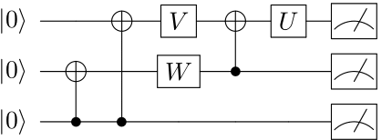
Quantum Computing 101
Ideal computational model:
prepare N systems in initial state
apply a sequence of gates
measure all systems independently
Produces samples from a distribution over 2^{N} outcomes

Slide 3
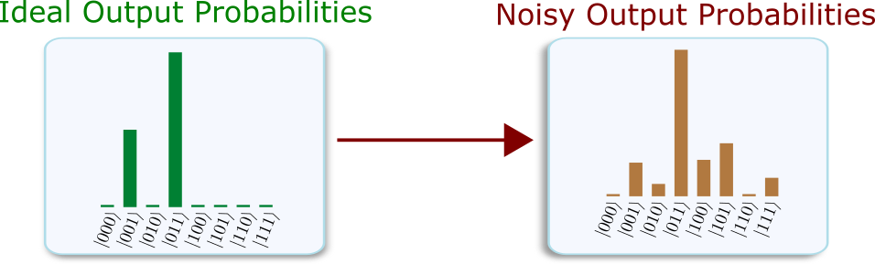
Computational Error
Error: a deviation from accuracy or correctness

Slide 4
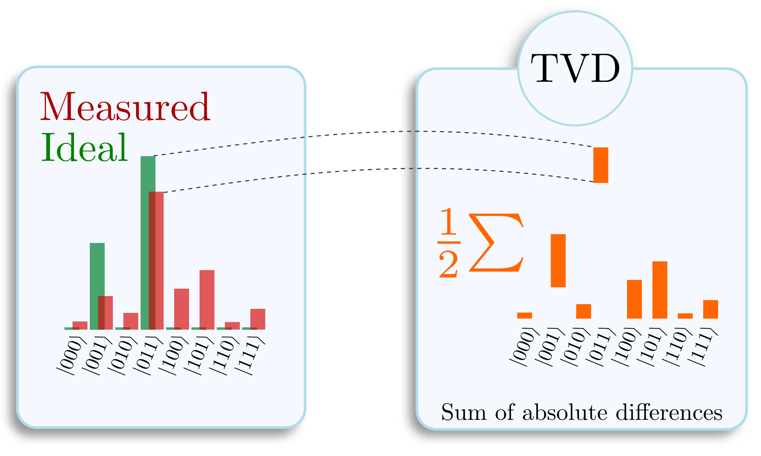
Computational Error
Outcomes from an experimental quantum computer are equivalent to ideal sampling and transmitting the result through a noisy classical channel
The probability that the noisy channel causes an error is the total variation distance (TVD)

Slide 5

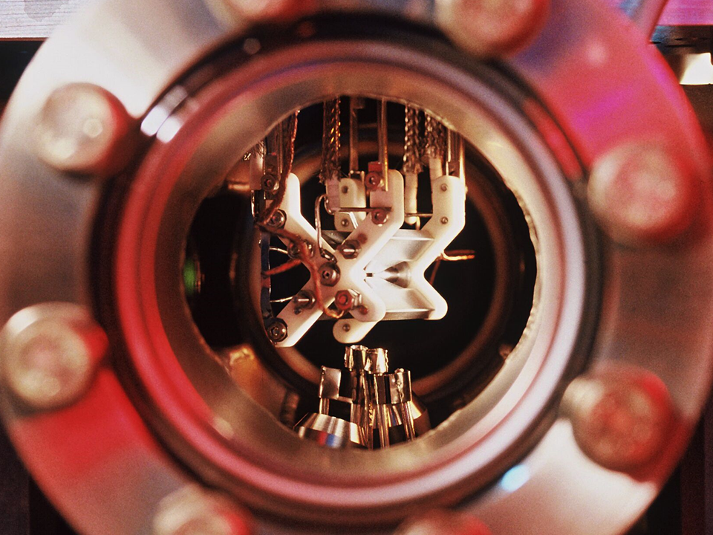
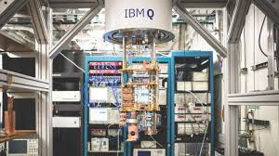
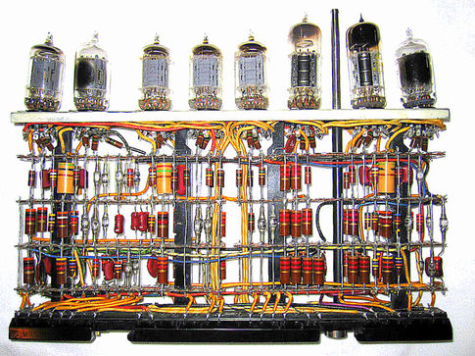
Noisy Quantum Computers
(Quantum) computers never work perfectly

Slide 6
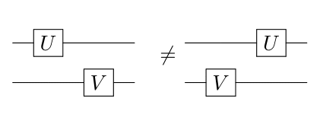
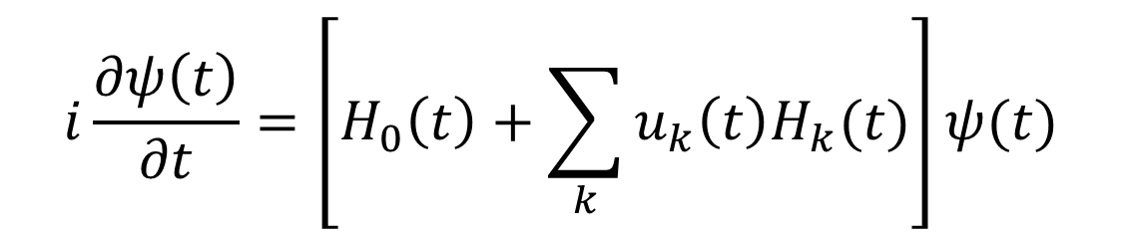
Murphy’s law
Evolution determined by control pulses, Hamiltonians
Possible errors: every term
$$i\frac{∂ψ\left(t\right)}{∂t}=\left[H_{0}\left(t\right)+\sum_{k}{u_{k}\left(t\right)H_{k}(t)}\right]ψ(t)$$
(under crosstalk)

Slide 7
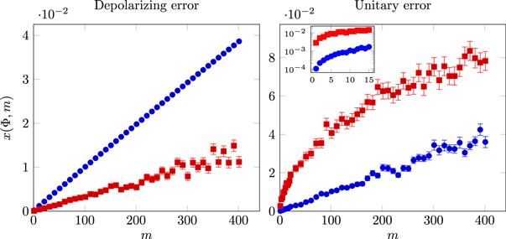
Component Errors
Computational error arises from component errors
Context-independent errors: T1/T2, depolarizing
Context-dependent errors: coherent errors
Contribution fluctuates by orders of magnitude

Slide 8
Component Errors
Errors depend on how you parallelize (and the history)
Errors per one- and two-qubit gate are misleading:
The rest of the system does not idle perfectly (people think you can serialize)
The effect of the error depends upon the context

Slide 9
Implementing Quantum Computers
The conventional approach:
construct effective gates acting on small subsystems
characterize noise on individual gates
stitch individual noise models together
use quantum error correction
Need to characterize gates as they are implemented.

Slide 10
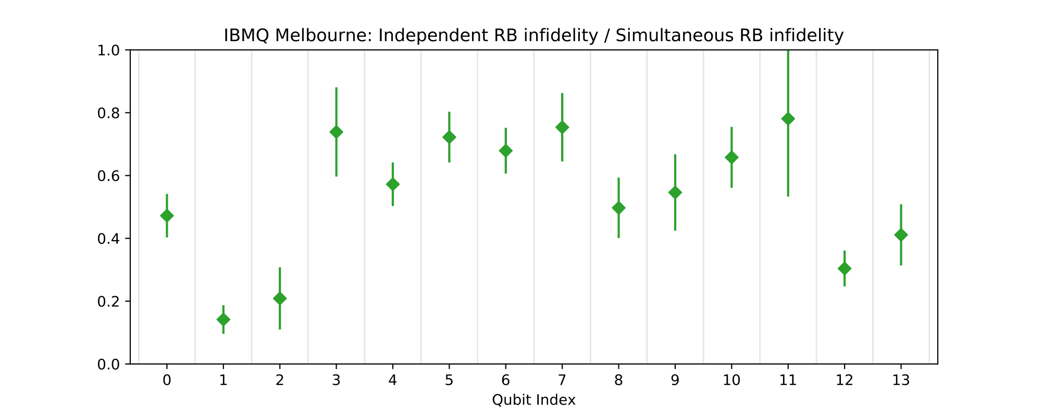
E.g., cross-talk IBM Q
Cross-talk introduces significant gate-dependent coherent errors that depend on what gates are implemented simultaneously

Slide 11
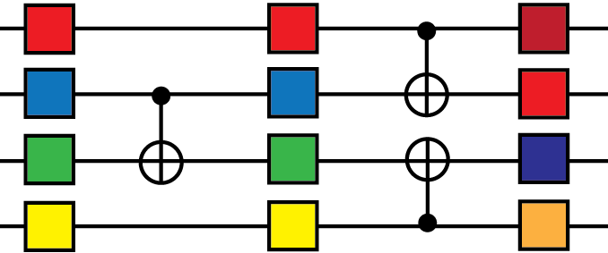
Cycles
A cycle is a set of gates applied in parallel in a fixed time slice
A circuit is a list of cycles, fixes parallelization
Relevant error is the error of the cycle, not the individual gates

Slide 12
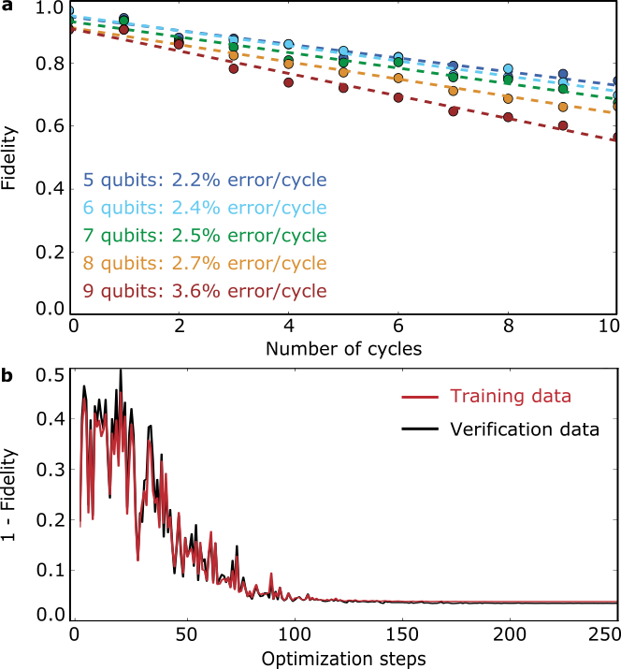
Cycles
Large gains can be achieved by optimizing each cycle
Gains should increase at least linearly with the number of qubits
C Neill et al., Science 13, 4309

Slide 13
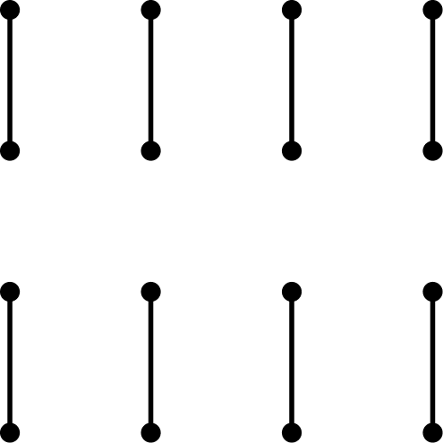
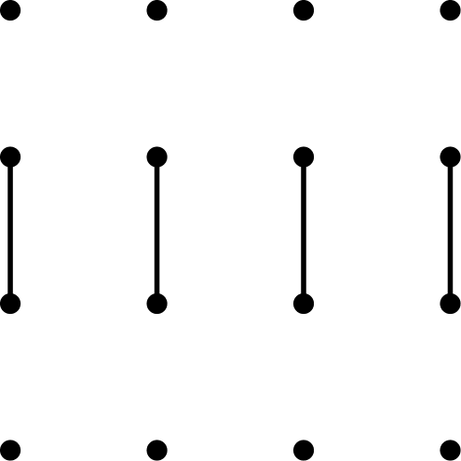


Cycles
Need to minimize how many cycles are calibrated and monitored
Naïve approaches gives exponential number of cycles or increases circuit time
Can use 3 types of cycles:
Independent simultaneous Z rotations
Simultaneous X90 on all qubits
O(1)/4 parallel multi-qubit cycles

Slide 14
Cycles
For any n, can implement any cycle of:
Independent single-qubit gates can be implemented with 2 X cycles, 3 Z cycles
Independent two-qubit unitary gates on any configuration with 3 fixed multi-qubit cycles
Optimal gain from calibrating all possible cycles is only 3x better than calibrating 4 Clifford cycles

Slide 15
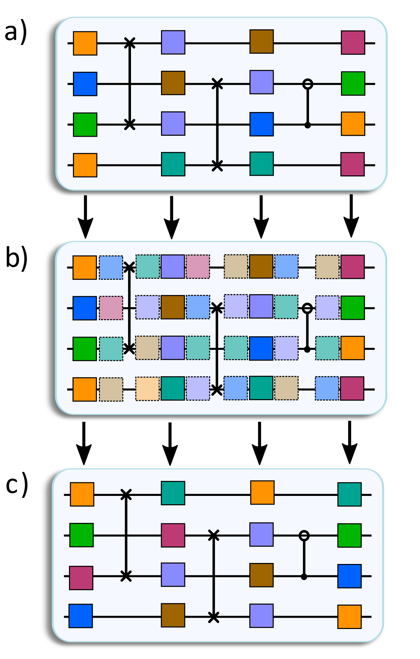
Randomized compiling
Error in cycles is well-defined, can include coherent errors due to cross-talk, etc
Randomize single-qubit operations, average over independent realizations
Little to no overhead
Effective error is stochastic, well-defined error rate per cycle independent of context

Slide 16
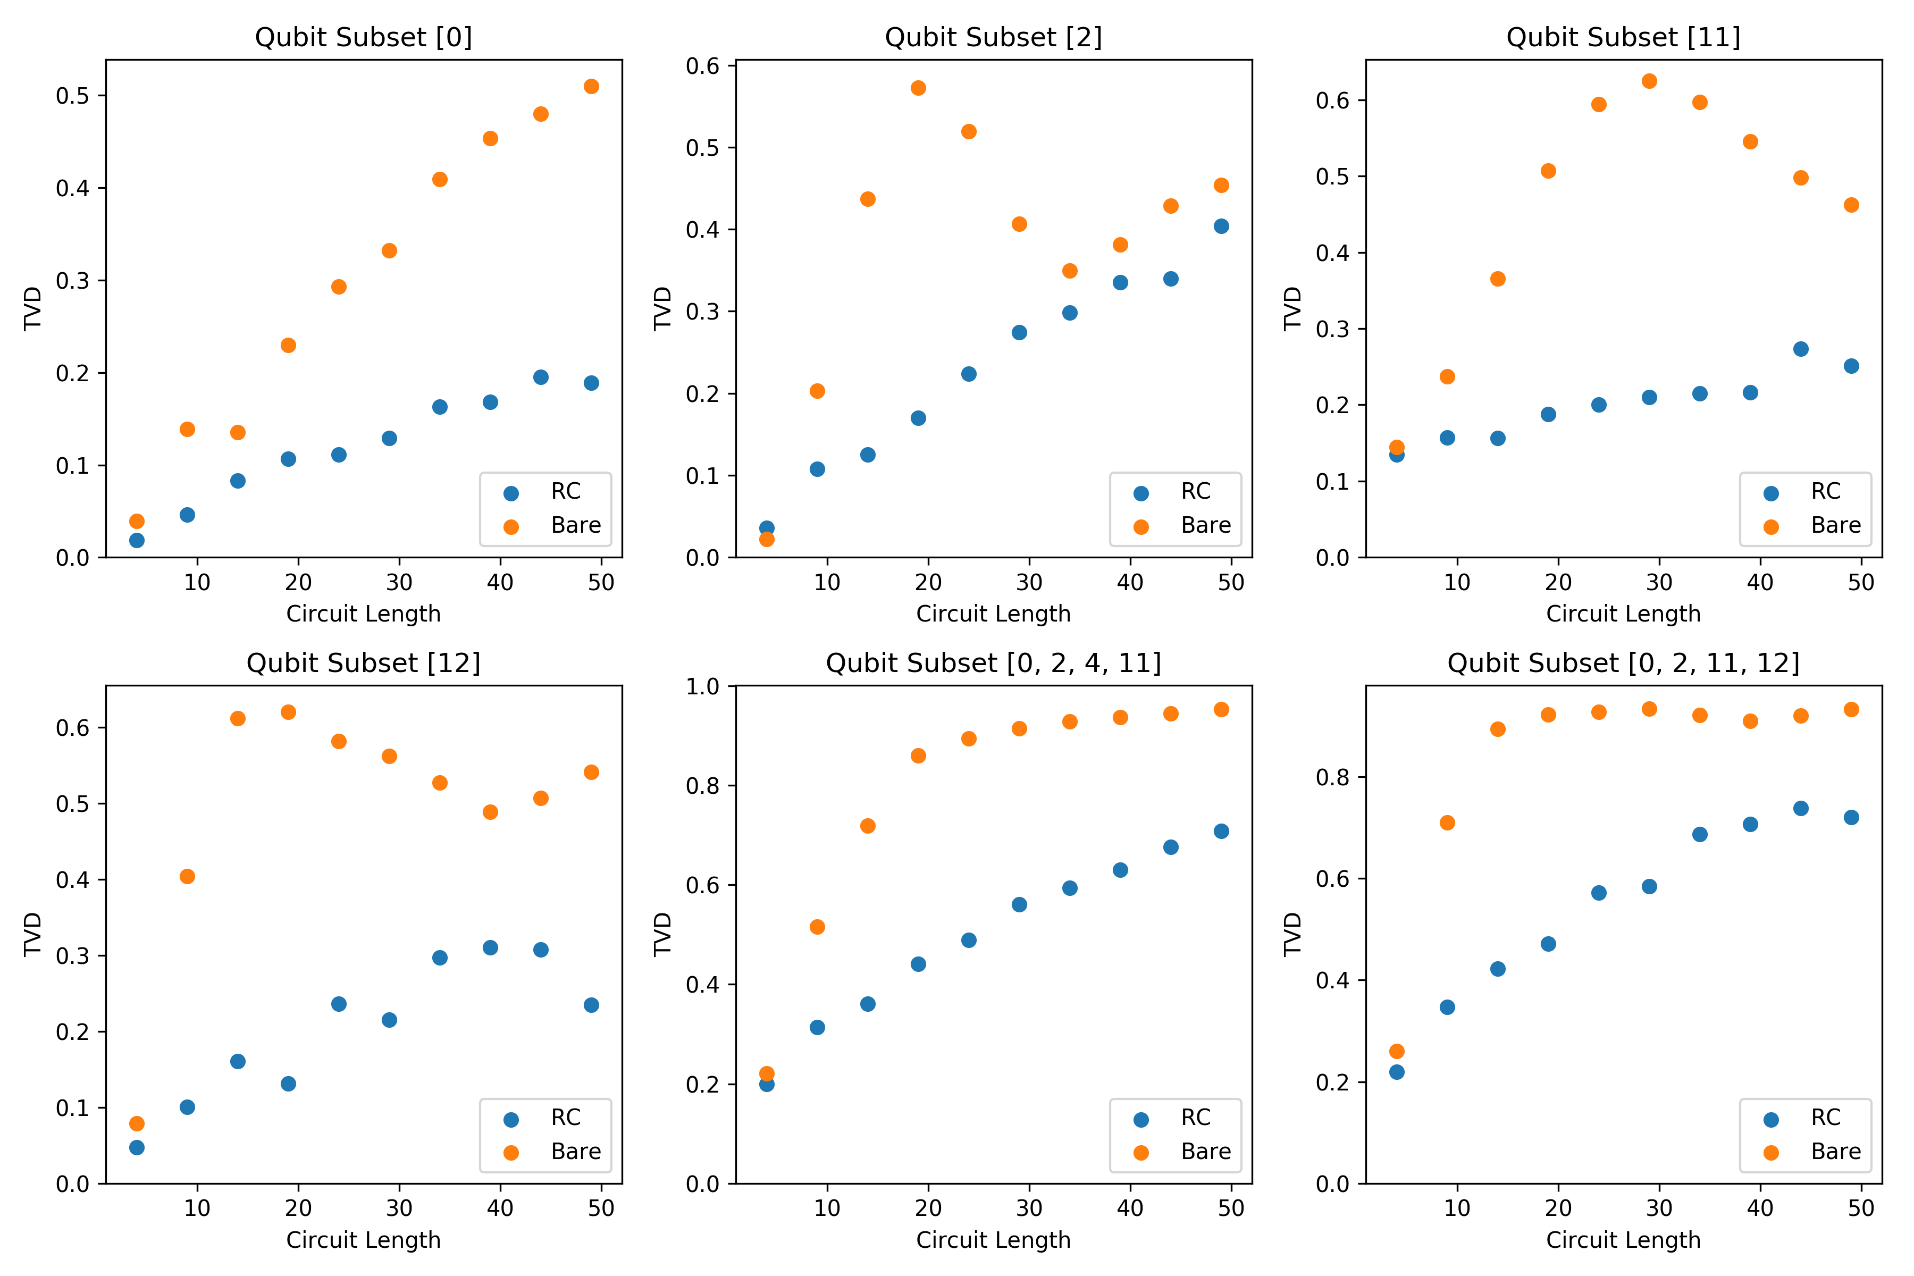
Randomized compiling
Data from IBM Q Melbourne
Reduced errors and predictable error rates!
Probability of inaccurate solution

Slide 17
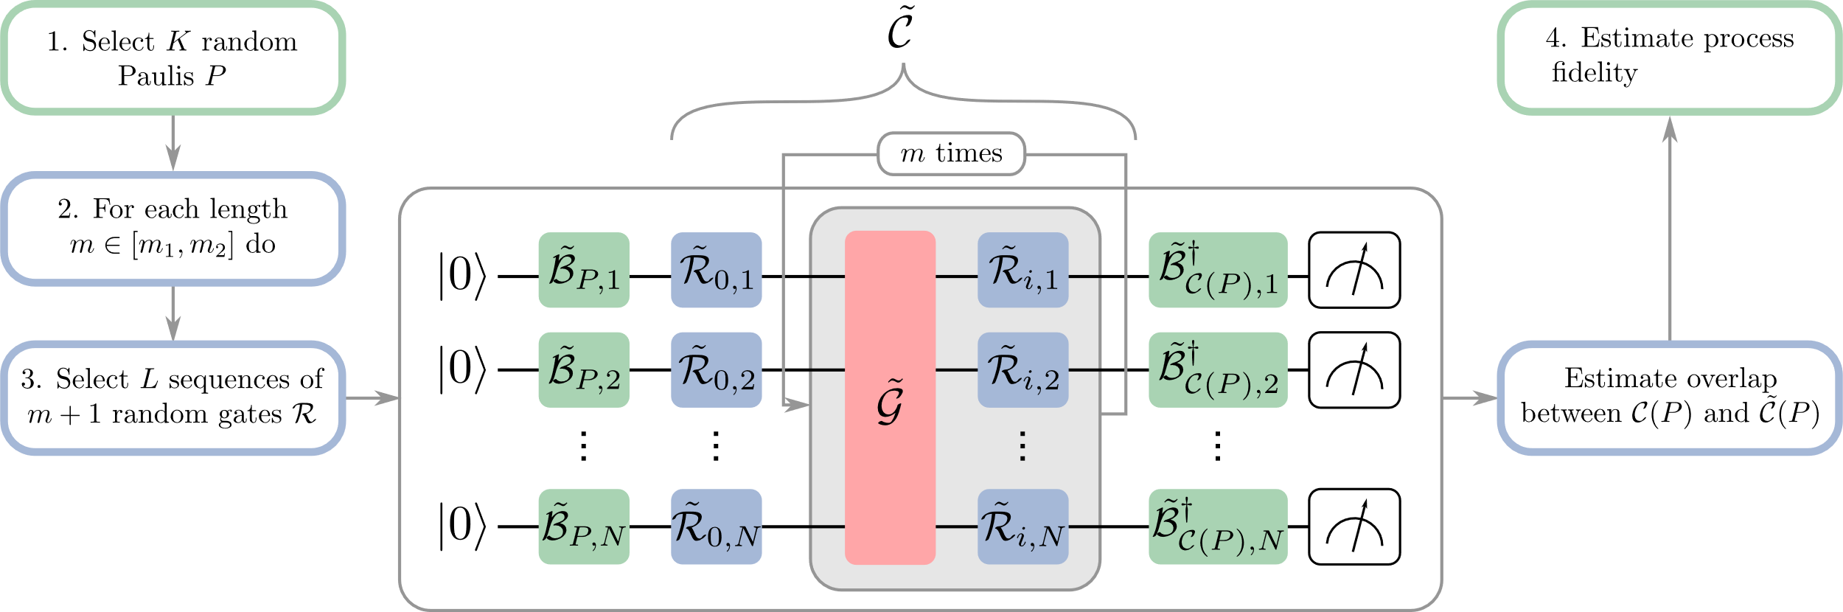
Cycle benchmarking
Can estimate the error per cycle efficiently in the number of qubits via a variant of RB
Can alternate interleaved cycles to study interactions between cycles

Slide 18
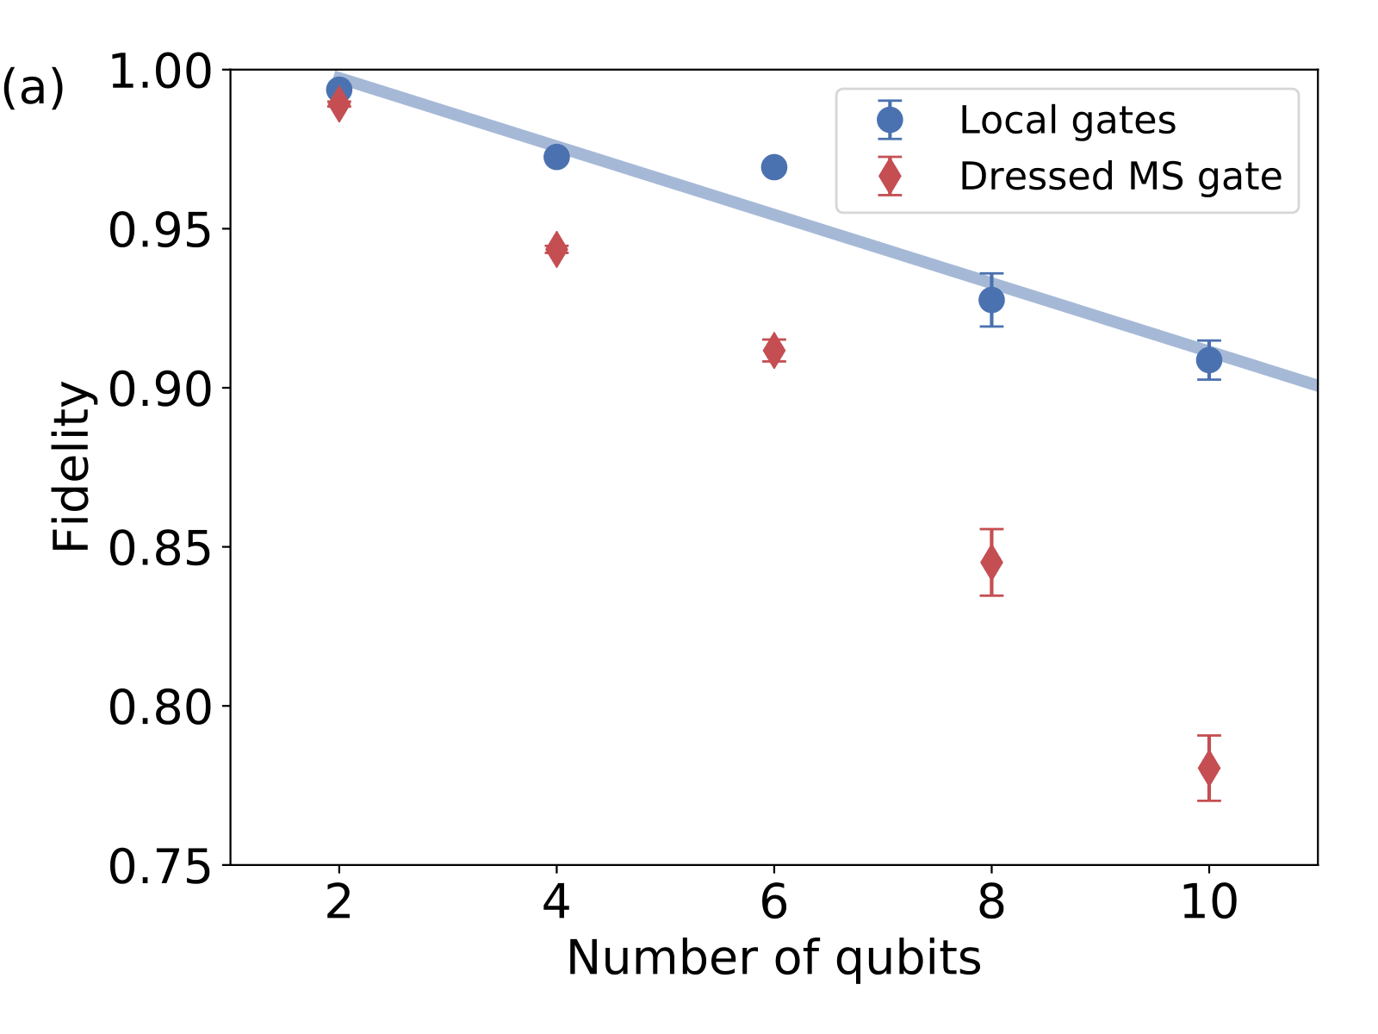
Cycle benchmarking
Experimentally implemented on up to 10 qubits with an all-to-all entangling gate
Used 400 circuits, 100 repetitions per circuit per cycle

Slide 19
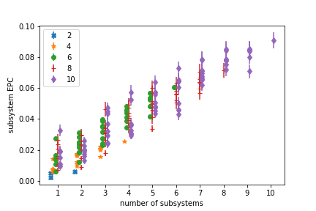
Cycle benchmarking
Data from UIBK
Same calibrations can be used even for subsets of qubits
Can choose the best subset of qubits and estimate the error rates with no experimental overhead

Slide 20
Noise reconstruction
Cycle benchmarking gives different decay curves that are separately fitted and averaged to get an average process fidelity
Can also sample and transform these decay curves to efficiently reconstruct the underlying error channel
The error can be used to identify recalibrations and to design fault-tolerant circuits and gadgets

Slide 21
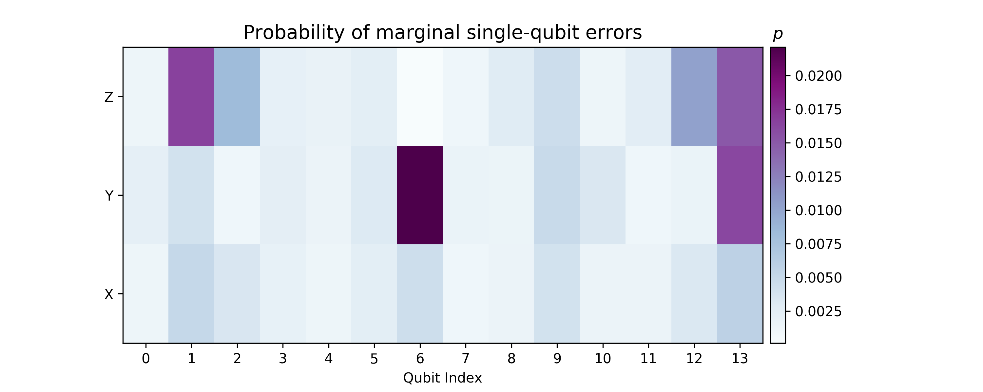
Noise reconstruction
Data from IBM Q Melbourne
E.g., one day automatic calibration of IBM Q resulted in an unexpectedly large error on one qubit

Slide 22
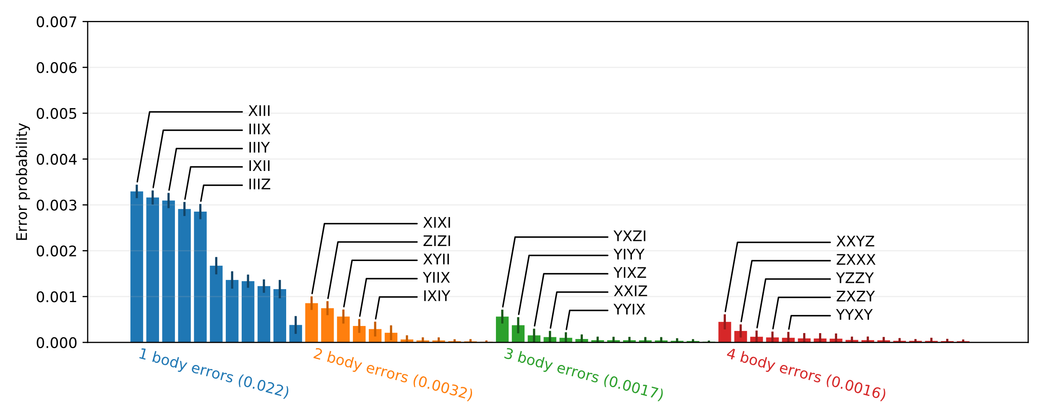
Noise reconstruction
Data from UIBK
Error in a round of 4 independent single-qubit gates, errors primarily local but some correlated errors

Slide 23
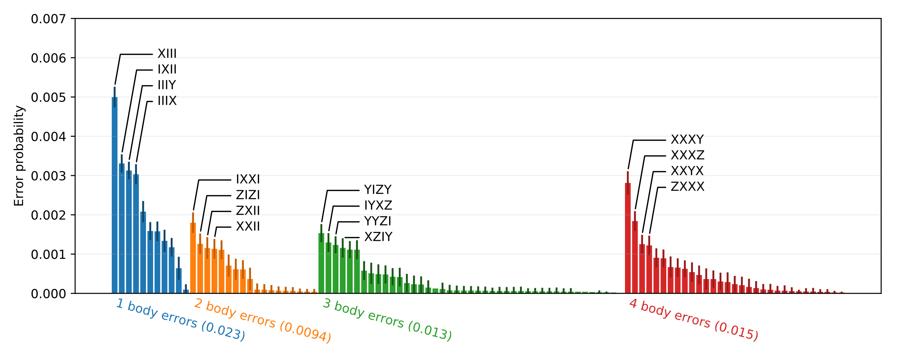
Noise reconstruction
Data from UIBK
Errors in a 4-qubit all-to-all entangling gate, extra errors primarily due to many-body errors

Slide 24



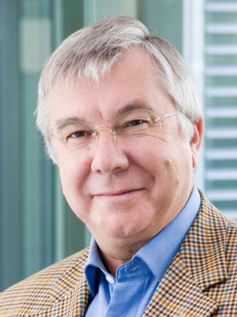
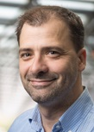
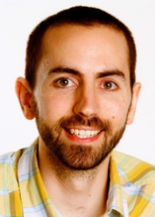


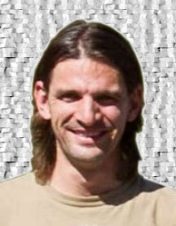
Acknowledgements
Funding
Collaborators
R Blatt
U.Innsbruck
J Emerson
U.Waterloo
S Flammia
U.Sydney
R Harper
U.Sydney
T Monz
U.Innsbruck
P Schindler
U.Innsbruck

Slide 25


Open positions!
Institute for Quantum Computing, University of Waterloo
3 postdoc positions with Emerson/Wallman
Characterization of quantum devices and open quantum systems theory
Quantum Algorithms
Quantum Foundations and Quantum Resources
https://services.iqc.uwaterloo.ca/applications/positions/iqc-postdoctoral-fellowship/
Quantum Benchmark Inc.
Research Scientist
Chief Product Officer
2 software developers
Contact Jemerson@quantumbenchmark.com
School of Physics, University of Sydney
Multiple postdoc positions with Flammia
http://bit.ly/SydneyPostdoc2019

Slide 26
Quantum Benchmark Software
Achieve reliable quantum solutions with unreliable quantum hardware.
TRUE-Q™ DESIGN
For QC scientists to improve design of hardware and quantum control:
Assess and suppress errors
Improve hardware design
Optimize qubit control
Fast tune-up
Minimize error correction overheads
Optimize decoder
TRUE-Q™ OS
For QC users to optimize run-time performance & accuracy of solutions
Universal transpiler between circuit formats
Monitor drift & fast tune-up
Suppress run-time errors
Error-aware compiler to optimize application performance
Validate accuracy of solutions
Notes:
Sample PRODUCTS slide.

